Slide 1
Term Project
Team B.S.
B.S. Poker
Jimmy Chung
Yuning Hong
Jordan Leong
Steven Lum

Slide 2
Game Overview
-Players start with X amount of cards
-All players share hands similar to Texas Hold ‘em
-Wild cards make game fun!
-Players take turns calling the highest hand (e.g. 7 Aces)
-Call B.S. on hand you think doesn’t exist
-Loser of round is person with wrong hand or the B.S’er.
-SUDDEN DEATH

Slide 3
WireFrames
On the next page

Slide 4
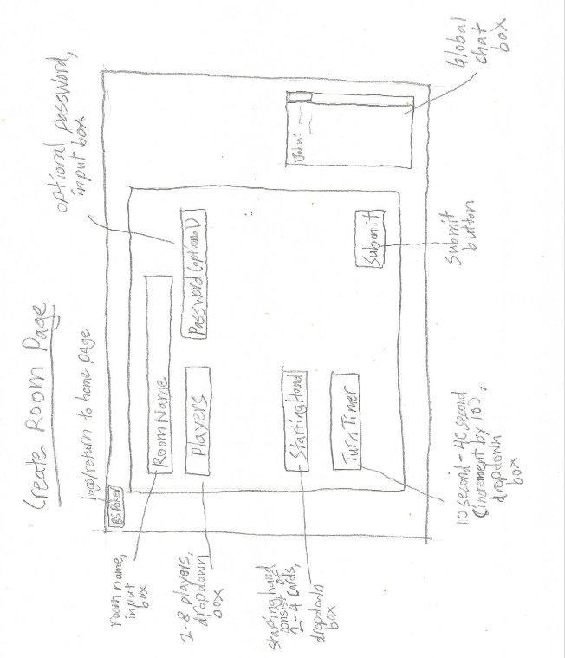

Slide 5
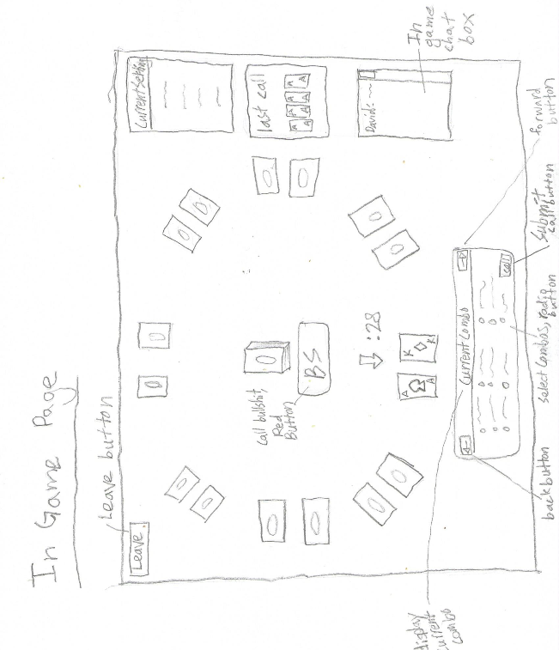

Slide 6
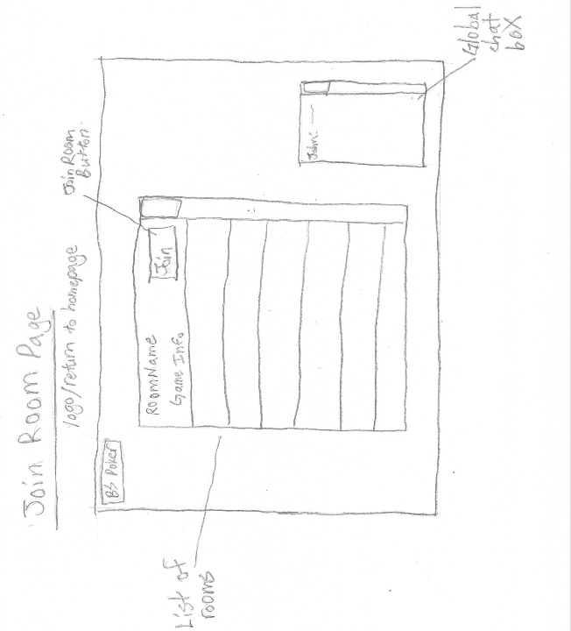

Slide 7
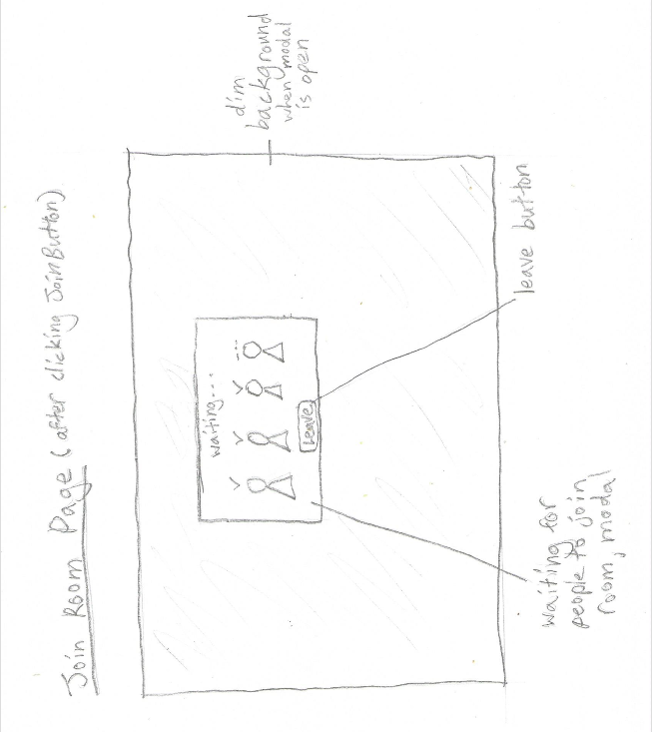

Slide 8
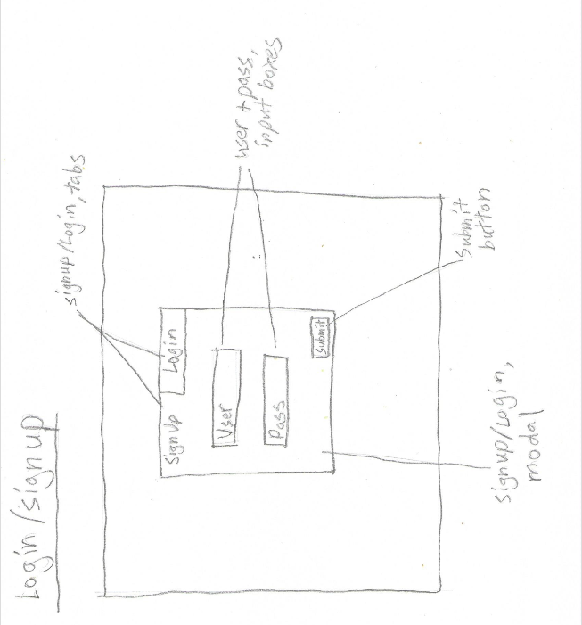

Slide 9
End of Presentation
Any Questions?

